Slide 1
Artificial Intellijence
FIT (Software 1st)

Slide 2
Artificial Intelligence
Artificial intelligence is the simulation of human intelligence processes by machines, especially computer systems
Behaviour by a machine that, if performed by a human being, would be called intelligent
The 3 main objectives of artificial intelligence are to make machines smarter, to understand what intelligence is and to make machine more useful

Slide 3
Capabilities of AI
Learning & understanding from experience
Making sense of ambiguous or contradictory messages
Responding quickly & successfully to a new situation
Using reasoning to solve problems
Dealing with complex situations
Applying knowledge to manipulate the environment
Recognizing the relative importance of different elements

Slide 4
Advantages of AI
AI is more permanent
AI can be less expensive
AI is consistent and thorough
AI can be documented
AI offers ease of duplication and dissemination

Slide 5
Advantages of Natural Intelligence
Natural intelligence is creative
Natural intelligence use direct sensory experience
Natural intelligence enables people to recognise relationships between things
Human reasoning is always able to make use of a wide context of experience

Slide 6
Conventional Computing vs AI computing
Dimension | Conventional | AI
Processsing | Algorithmic | Include symbolic conceptualization
Nature of input | Must be complete | Can be incomplete
Focus | Data, information | Knowledge
Reasoning capability | No | Yes

Slide 7
Commercial AI Systems
Expert systems
Natural Language Processing(NLP)
Speech recognition
Robotics & sensory systems
Computer vision
Intelligent computer-aided instruction
Intelligent agents

Slide 8
Weak AI
Weak AI, also known as narrow AI, is artificial intelligence with limited functionality.
It refers to the use of advanced algorithms to accomplish specific problem solving or reasoning tasks that do not encompass the full range of human cognitive abilities.
Weak AI relies on human interference to define the parameters of its learning algorithms and to provide the relevant training data to ensure accuracy.
Example: Siri, Alexa

Slide 9
Strong AI
Strong AI is a theoretical form of machine intelligence which supports the view that machines can really develop human consciousness equal to human beings.
Strong AI can perform a variety of functions, eventually teaching itself to solve for new problems.
While human input accelerates the growth phase of Strong AI, it is not required, and over time, it develops a human-like consciousness instead of simulating it

Slide 10
Fuzzy Logic
Fuzzy logic is an approach to variable processing that allows for multiple possible truth values to be processed through the same variable.
Fuzzy logic is designed to solve problems by considering all available information and making the best possible decision given the input.

Slide 11
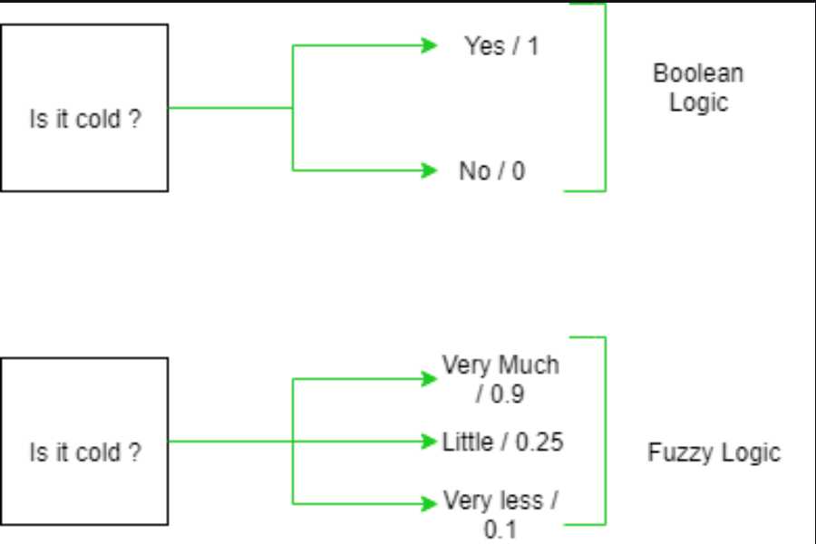
Fuzzy Logic
In the boolean system truth value, 1.0 represents the absolute truth value and 0.0 represents the absolute false value. But in the fuzzy system, there is no logic for the absolute truth and absolute false value. But in fuzzy logic, there is an intermediate value too present which is partially true and partially false.

Slide 12
Advantages of Fuzzy Logic System
This system can work with any type of inputs whether it is imprecise, distorted or noisy input information.
Fuzzy logic comes with mathematical concepts of set theory and the reasoning of that is quite simple.
It provides a very efficient solution to complex problems in all fields of life as it resembles human reasoning and decision-making.
The algorithms can be described with little data, so little memory is required.

Slide 13
Disadvantages of Fuzzy Logic
Many researchers proposed different ways to solve a given problem through fuzzy logic which leads to ambiguity. There is no systematic approach to solve a given problem through fuzzy logic.
Proof of its characteristics is difficult or impossible in most cases because every time we do not get a mathematical description of our approach.
As fuzzy logic works on precise as well as imprecise data so most of the time accuracy is compromised.

Slide 14
Applications of Fuzzy Logic System
It is used in the aerospace field for altitude control of spacecraft and satellites.
It has been used in the automotive system for speed control, traffic control.
It is used for decision-making support systems and personal evaluation in the large company business.
It has application in the chemical industry for controlling the pH, drying, chemical distillation process.
Fuzzy logic is used in Natural language processing and various intensive applications in Artificial Intelligence.
Fuzzy logic is extensively used in modern control systems such as expert systems.

Slide 15
Expert Systems
An expert system is a computer program that is designed to solve complex problems and to provide decision-making ability like a human expert.
These systems are designed for a specific domain, such as medicine, science, etc.
The performance of an expert system is based on the expert's knowledge stored in its knowledge base.
One of the common examples of an ES is a suggestion of spelling errors while typing in the Google search box.

Slide 16
Capabilities of ES
Advising
Instructing and assisting human in decision making
Demonstrating
Deriving a solution
Diagnosing
Explaining
Interpreting input
Predicting results
Justifying the conclusion
Suggesting alternative options to a problem

Slide 17
Components of ES
Knowledge Base
Inference Engine
User Interface

Slide 18
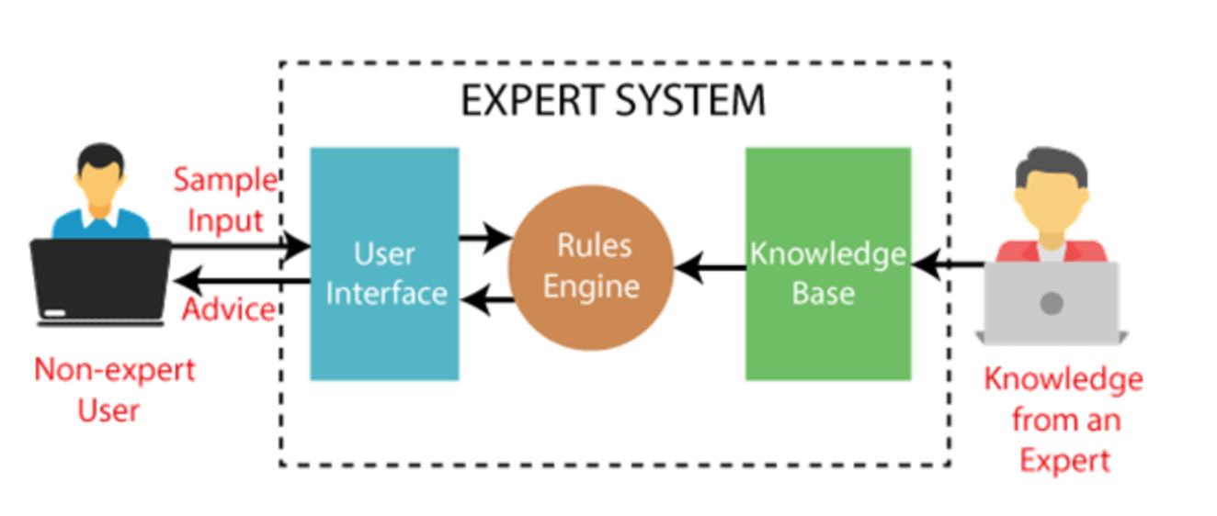

Slide 19
Knowledge Base
It is a type of storage that stores knowledge acquired from the different experts of the particular domain.
It contains domain-specific and high-quality knowledge
It is similar to a database that contains information and rules of a particular domain or subject.

Slide 20
2. Inference Engine
The inference engine is the main processing unit of the system.
It applies inference rules to the knowledge base to derive a conclusion or deduce new information.
It helps in deriving an error-free solution of queries asked by the user.
With the help of an inference engine, the system extracts the knowledge from the knowledge base.

Slide 21
3. User Interface
It is an interface that helps a non-expert user to communicate with the expert system to find a solution.
After getting the response from the inference engine, it displays the output to the user.

Slide 22
Advantages of ES
These systems are highly reproducible.
They can be used for risky places where the human presence is not safe.
Error possibilities are less if the KB contains correct knowledge.
The performance of these systems remains steady as it is not affected by emotions, tension, or fatigue.
They provide a very high speed to respond to a particular query.

Slide 23
Limitations of ES
The response of the expert system may get wrong if the knowledge base contains the wrong information.
Like a human being, it cannot produce a creative output for different scenarios.
Its maintenance and development costs are very high.
Knowledge acquisition for designing is much difficult.
For each domain, we require a specific ES, which is one of the big limitations.
It cannot learn from itself and hence requires manual updates.

Slide 26
Applications of ES
Designing and Manufacturing domain: Eg. Camera lens design
Medical domain : Eg. Diagnosis Systems
Monitoring Systems
Knowledge Domain: Eg. Finding out faults in vehicles, computers.
Finance/Commerce: Eg. Detection of possible fraud, suspicious transactions, stock market trading, Airline scheduling, cargo scheduling.

Slide 27
Decision Support System (DSS)
A decision support system (DSS) is a computerized program used to support determinations, judgments, and courses of action in an organization or a business
Decision support systems (DSS) are interactive software-based systems intended to help managers in decision-making by accessing large volumes of information
DSS uses the summary information, exceptions, patterns, and trends using the analytical models.

Slide 28
Components of DSS
Data Management: It includes database or set of files that contains relevant data for the decision situation
User Interface: It enables the user to communicate and command the DSS

Slide 29
Components of DSS
Model Management: It includes software with financial, statistical or other quantitative models. It provides systems’ s analytical capabilities
Knowledge Management: It supports other subsystems or act as an independent component, providing knowledge for the solution of the specific problem

Slide 30
Attributes of DSS
Adaptability and flexibility
High level of Interactivity
Ease of use
Efficiency and effectiveness
Complete control by decision-makers
Ease of development
Extendibility
Support for modeling and analysis
Support for data access
Standalone, integrated, and Web-based

Slide 31
Characteristics of DSS
Support for decision-makers in semi-structured and unstructured problems.
Support for managers at various managerial levels, ranging from top executive to line managers.
Support for individuals and groups. Less structured problems often requires the involvement of several individuals from different departments and organization level.
Support for interdependent or sequential decisions.
Support for intelligence, design, choice, and implementation
Support for variety of decision processes and styles.
DSSs are adaptive over time.

Slide 32
Benefits of DSS
Improves efficiency and speed of decision-making activities.
Increases the control, competitiveness and capability of futuristic decision-making of the organization.
Since it is mostly used in non-programmed decisions, it reveals new approaches and sets up new evidences for an unusual decision.
Helps automate managerial processes.

Slide 33
Knowledge Management
Knowledge management is the process by which an enterprise gathers, organizes, shares and analyzes its knowledge in a way that is easily accessible to employees.
Successful knowledge management includes maintaining information in a place where it is easy to access.

Slide 34
Types of Knowledge
Explicit knowledge (knowledge that is easy to write down and share)
‍Implicit knowledge (applied knowledge)‍
Tacit knowledge (knowledge gained from personal experience)

Slide 35
Knowledge Management Activities
Knowledge Identification: Determines what knowledge information is critical to decision making
Knowledge Discovery and Analysis: By use of search engines, databases and data mining, the proper knowledge must be found, analyzed and put into right context

Slide 36
KM Activities
Knowledge Acquisition: collect and gather knowledge using software tools
Knowledge creation: Some knowledge can be created using idea-generating techniques

Slide 37
KM Activities
Establishment of organizational knowledge base: It is a process of accumulating and establishing broader corporate knowledge for solving variety of problems
Knowledge distribution and use: Target audiences are defined and technologies are put into place to enable knowledge delivery

Slide 38
Benefits of KM
Faster decision-making
Efficient access to knowledge and information
Increased collaboration and idea generation
Enhanced communication throughout your organization
Improved quality of information and data
More security for intellectual property
Optimized training

Slide 39
Intelligent Agents
An intelligent agent is a program that can make decisions or perform a service based on its environment, user input and experiences.
It is an entity that makes a decision, that enables artificial intelligence to be put into action

Slide 40
Applications of IA
Information access and navigation
Decision support
Repetitive office activities
Mundane personal activities
Search and retrieval
E-commerce agents
Managing activities
Domain Expert

Slide 41
